Slide 1

Unit 2 Types of Testing
By: Anand C Unakal

Slide 2
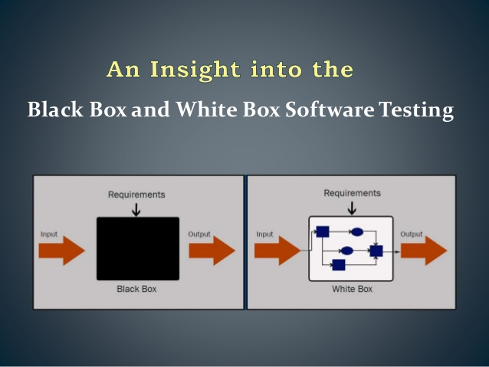

Slide 3
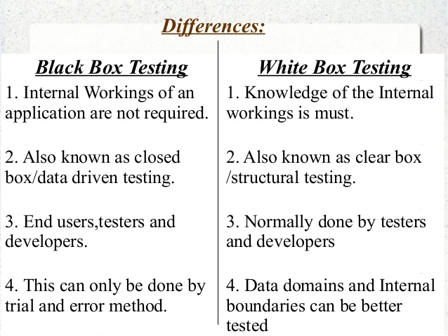

Slide 4
HOW TO DO BLACK BOX TESTING?
various techniques:
Requirements based testing
Positive and negative testing
Boundary value analysis
Decision tables
Equivalence partitioning
State based testing
Compatibility testing
User documentation testing
Domain testing

Slide 5
Requirements Based Testing
Requirements testing deals with validating the requirements given in the Software Requirements Specification (SRS) of the software system.
The precondition for requirements testing is a detailed review of the requirements specification.
Requirements review ensures that they are consistent, correct, complete and testable.

Slide 6
Positive and negative testing
Positive testing tries to prove that a given product does what it is supposed to do.
Test case verifies the requirements of the product with a set of expected output.
Negative testing is done to show that the product does not fail when an unexpected input is given
The purpose of negative testing is to try and break the system.

Slide 7
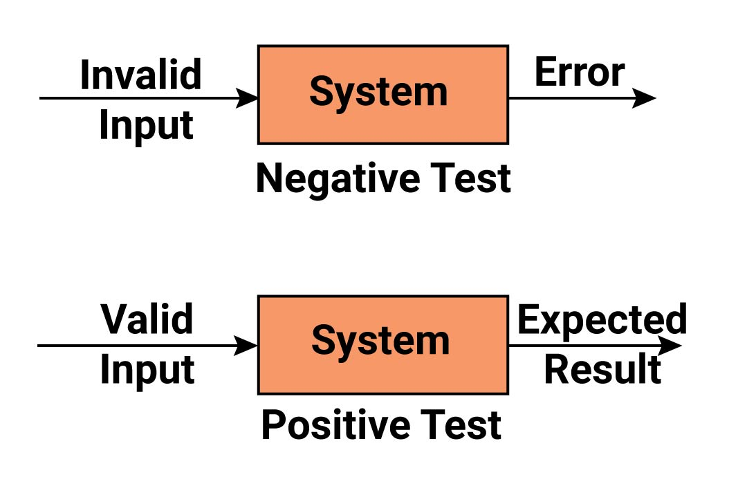

Slide 8
Boundary value analysis
Boundary value analysis is a method of arriving at tests that are effective in catching defects that happen at boundaries
It is useful to generate test cases when the input(or output)data is made up of clearly identifiable boundaries or ranges.
Also include in the list of boundary values, documented limits on hardware resources. For example, if it is documented that a product will run with minimum 4GB of RAM, make sure you include test cases for the minimum RAM

Slide 9
Decision tables
A program’s behavior is characterized by several decision variables.
Each decision variable specifies a Boolean condition.
The distinct combinations of these decision variables lead to different scenarios.
One representative data point from each scenario needs to be tested.

Slide 10
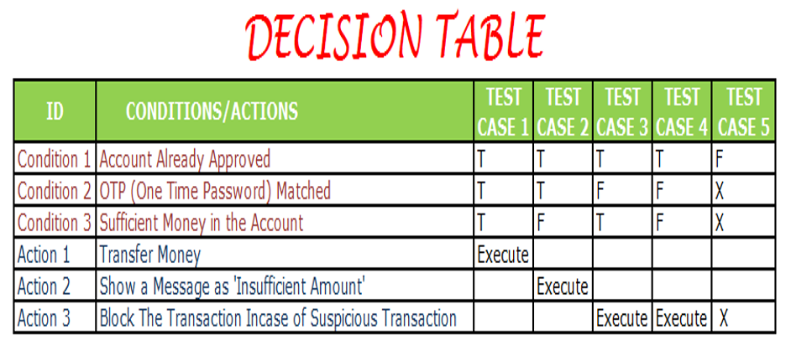

Slide 11
Equivalence partitioning
Generalization of BVA / decision table
Divide the (potentially infinite) set of values into a set of equivalence classes or partitions
It is useful to minimize the number of test cases when the input data can be divided into distinct sets.

Slide 12
State based testing
Useful for
- Language processors or compilers
- Workflow modelling
- Dataflow modelling

Slide 13
Compatibility testing
To ensure that the product works consistently with infrastructure components
Could be parameters of hardware, OS, network

Slide 14
User documentation testing
To check if what is stated in the document is available in the product
To check if what is there in the product is available in the document
Documents include user guides, installation guides, set-up guides, read-me files, software release notes and on-line help

Slide 15
Domain testing
Have “domain people” perform tests by using the software
Business flow determines the test, not “logic” or “steps”
Tests what the users do on a typical business day and captures the typical problems faced by users (not necessarily captured in SRS)

Slide 16
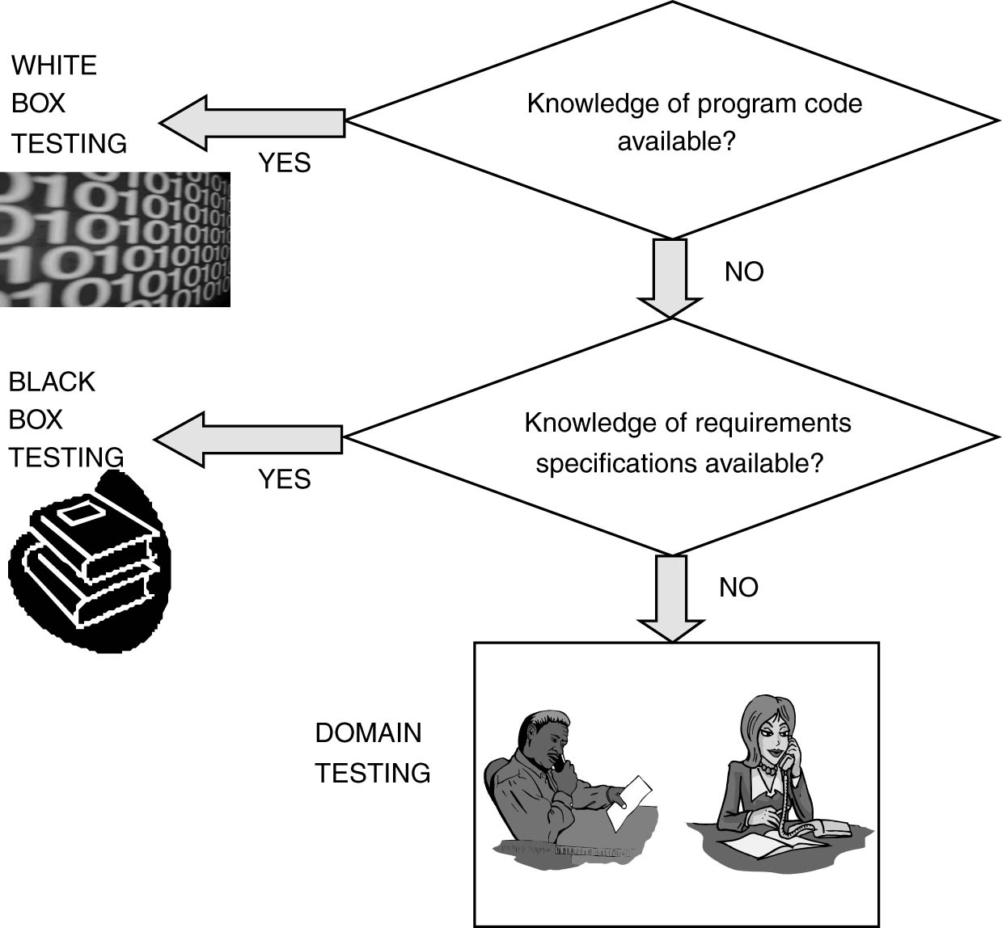
Domain testing

Slide 17
Integration Testing
A system is made up multiple components or modules that can comprise hardware and software.
Integration is defined as the set of interactions among components.
Testing the interaction between the modules and interactions with other systems externally is called integration testing

Slide 18
Integration Testing
Internal interfaces are those that provide communication across two modules within a project or product, internal to the product, and not exposed to the customer or external developers.
External or Exported interfaces are those that are visible outside the product to third party developers and solution providers.

Slide 19
Integration Testing as a Type of Testing
Top-down integration
Bottom-up integration
Bi-directional integration
System integration

Slide 20
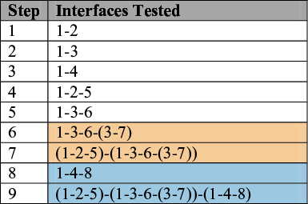
Top-down Integration
Component
1
Component
2
Component
3
Component
4
Component
5
Component
6
Component
7
Component
8

Slide 21
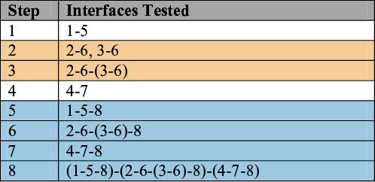
Bottom-up Integration
Component
8
Component
5
Component
6
Component
7
Component
1
Component
2
Component
3
Component
4

Slide 22
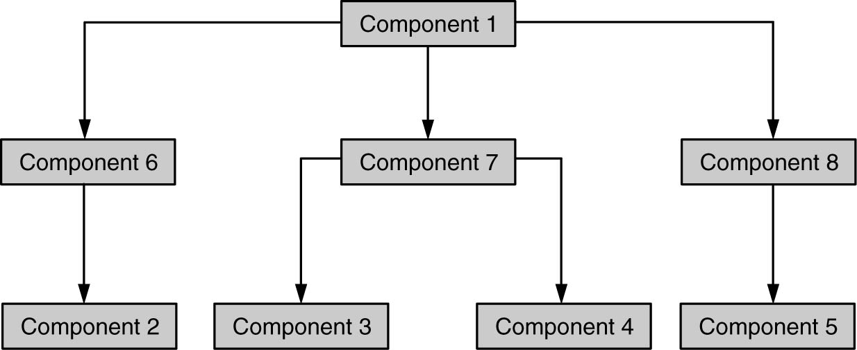
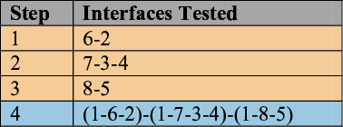
Bi-Directional Integration

Slide 23
System or big-bang integration
System integration means that all the components of the system are integrated together and tested as an entire unit.
System integration saves time and effort.

Slide 24
Integration Testing Phase Defect Bash
Defect bash is an ad hoc testing, done by people performing different roles to bring out all types of defects
Defect bash brings together plenty of good practices
Enabling people to “cross boundaries and test beyond assigned area”
Bringing different people performing different roles together in the organization for testing - “Testing isn’t for testers alone”

Slide 25
Integration Testing Phase Defect Bash
Let everyone in organization use the product before delivery - “Eat your own dog food”
Bringing in people who have different levels of product understanding, to test the product together randomly – “Users of software are not the same”

Slide 26
System Testing Overview
System testing is defined as a testing phase conducted on the complete integrated system, to evaluate the system compliance with its specified requirements.
System testing is the only phase of testing which tests the both functional and non-functional aspects of the product.

Slide 27
System Testing Overview
On the non-functional side, system brings in different testing types (also called quality factors), some of which are as follows:
Performance/Load testing
Scalability Testing
Reliability testing
Stress testing
Interoperability testing
Localization testing

Slide 28
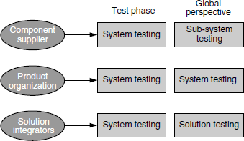
Different perspectives of system testing

Slide 29
WHY IS SYSTEM TESTING Done?
Provide independent perspective in testing
Bring in customer perspective in testing
Provide a “fresh pair of eyes” to discover defects not found earlier by testing
Test product behavior in a holistic, complete, and realistic environment
Test both functional and non-functional aspects of the product
Build confidence in the product
Ensure all requirements are met and ready the product for acceptance testing.

Slide 30
Functional testing versus non-functional testing
Testing aspects | Functional testing | Non-functional testing
Involves | Product features and functionality | Quality factors
Tests | Product behavior | Behavior and experience
Result conclusion | Simple steps written to check expected results | Huge data collected and analyzed
Results varies due to | Product implementation | Product implementation, resources, and configurations
Testing focus | Defect detection | Qualification of product
Knowledge required | Product and domain | Product, domain, design, architecture, statistical skills
Failures normally due to | Code | Architecture, design, and code

Slide 31
Testing aspects | Functional testing | Non-functional testing
Testing phase | Unit, component, integration, system | System
Test case repeatability | Repeated many times | Repeated only in case of failures and for different configurations
Configuration | One-time setup for a set of test cases | Configuration changes for each test case

Slide 32
Functional Testing
Functional testing is a way of checking software to ensure that it has all the required functionality that's specified within it.
There are multiple ways system functional testing is performed.
Some of the common techniques are given below.
Design/architecture verification
Business vertical testing
Deployment testing
Beta testing
Certification, standards, and testing for compliance.

Slide 33
Design/Architecture Verification
In this method of functional testing, the test cases are developed and checked against the design and architecture to see whether they are actual product-level test cases.
Business Vertical Testing
General purpose products like workflow automation systems can be used by different businesses and services. Using and testing the product for different business verticals such as insurance, banking, asset management, and so on, and verifying the business operations and usage, is called “business vertical testing.”

Slide 34
Deployment Testing
This type of deployment (simulated) testing that happens in a product development company to ensure that customer deployment requirements are met is called offsite deployment.
Beta Testing
Sending the product that is under test to the customers and receiving the feedback. This is called beta testing. This testing is performed by the customer and helped by the product development organization.

Slide 35
Certification, Standards and Testing for Compliance
-A product needs to be certified with the popular hardware, operating system, database, and other infrastructure pieces. This is called certification testing.
-Testing the product to ensure that these standards are properly implemented is called testing for standards.
- Compliance Testing the product for contractual, legal, and statutory compliance is one of the critical activities of the system testing team.

Slide 36
NON-FUNCTIONAL TESTING
Non-functional testing is the testing of a software application or system for its non-functional requirements: the way a system operates, rather than specific behaviors of that system.
Setting Up the Configuration
Coming up with Entry/Exit Criteria
Balancing Key Resources
Scalability Testing
Reliability Testing
Stress Testing
Interoperability Testing

Slide 37
Setting Up the Configuration
There are two ways the setup is done—simulated environment and real-life customer environment.
Due to varied types of customers, resources availability, time involved in getting the exact setup, and so on, setting up a scenario that is exactly real-life is difficult.
Due to several complexities involved, simulated setup is used for non-functional testing where actual configuration is difficult to get.

Slide 38
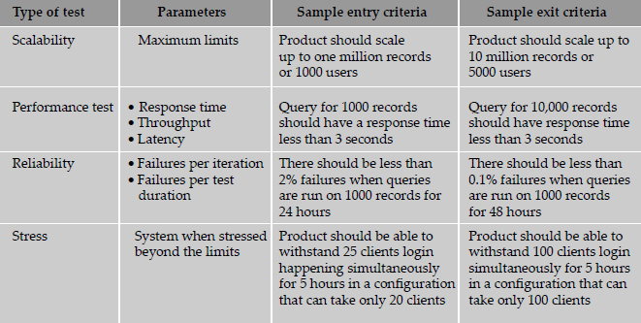
Coming up with Entry/Exit Criteria

Slide 39
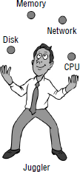
Balancing Key Resources
The concepts of non-functional testing with respect to four key resources—CPU, disk, memory, and network. The four resources are related to each other and we need to completely understand their relationship to implement the strategy for non-functional testing.

Slide 40
Scalability Testing
The objective of scalability testing is to find out the maximum capability of the product parameters.
As the exercise involves finding the maximum, the resources that are needed for this kind of testing are normally very high.
For example, one of the scalability test case could be finding out how many client machines can simultaneously log in to the server to perform some operations.

Slide 41
Reliability Testing
The reliability of a product deals with the different ways a quality product is produced, with very few defects by focusing on all the phases of product development and the processes.
Reliability here is an all-encompassing term used to mean all the quality factors and functionality aspects of the product.
This perspective is related more to the overall way the product is developed and has less direct relevance to testing.

Slide 42
Stress Testing
Stress testing is done to evaluate a system beyond the limits of specified requirements or resources, to ensure that system does not break.
Stress testing is done to find out if the product's behavior degrades under extreme conditions and when it is denied the necessary resources.
The product is over-loaded deliberately to simulate the resource crunch and to find out its behavior

Slide 43
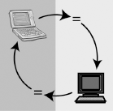
Interoperability Testing
Interoperability testing is done to ensure the two or more products can exchange information, use information, and work properly together.
Systems can be interoperable unidirectional (the exchange of information is one way) or bi-directional (exchange of information in both ways)

Slide 44
Description of testing | Belongs to
Testing interfaces between product components | Integration testing
Testing information exchange between two or more products | Interoperability testing
Testing the product with different infrastructure pieces such as OS, Database, Network | Compatibility testing
Testing whether the objects/binaries created with old version of the product work with current version | Backward compatibility testing
Testing whether the product interfaces work with future releases of infrastructure pieces | Forward compatibility testing
Testing whether the API interfaces of the product work with custom-developed components | API/integration testing

Slide 45
ACCEPTANCE TESTING
Acceptance testing is a phase after system testing that is normally done by the customers or representatives of the customer.
Acceptance tests are written to execute near real-life scenarios. Apart from verifying the functional requirements, acceptance tests are run to verify the non-functional aspects of the system also.

Slide 46
Acceptance Criteria:
Acceptance criteria-Product acceptance:
During the requirements phase, each requirement is associated with acceptance criteria.
It is possible that one or more requirements may be mapped to form acceptance criteria (for example, all high priority requirements should pass 100%).
Whenever there are changes to requirements, the acceptance criteria are accordingly modified and maintained.

Slide 47
2. Acceptance criteria—Procedure acceptance:
Acceptance criteria can be defined based on the procedures followed for delivery. An example of procedure acceptance could be documentation and release media.
3.Acceptance criteria–Service level agreements
Service level agreements (SLA) can become part of acceptance criteria.
Service level agreements are generally part of a contract signed by the customer and product organization.

Slide 48
Selecting Test Cases for Acceptance Testing
End-to-end functionality verification : Test cases that include the end-to-end functionality of the product are taken up for acceptance testing.
Domain tests :Since acceptance tests focus on business scenarios, the product domain tests are included. Test cases that reflect business domain knowledge are included.
User scenario tests : Acceptance tests reflect the real-life user scenario verification.

Slide 49
Basic sanity tests : Tests that verify the basic existing behavior of the product are included.
New functionality When the product undergoes modifications or changes, the acceptance test cases focus on verifying the new features.
A few non-functional tests Some non-functional tests are included and executed as part of acceptance testing to double-check that the non-functional aspects of the product meet the expectations.

Slide 50
Tests pertaining to legal obligations and service level agreements Tests that are written to check if the product complies with certain legal obligations and SLAs are included in the acceptance test criteria.
Acceptance test data Test cases that make use of customer real-life data are included for acceptance testing.

Slide 51
Executing Acceptance tests:
The customers themselves do the acceptance tests. In such cases, the job of the product organization is to assist the customers in acceptance testing and resolve the issues that come out of it. If the acceptance tests team becomes an important activity.

Slide 52
Thank You

